Slide 1
Convolutions and Correlations
most important operations when dealing with
signal processing (computational neuroscience )
combination of two signals → generate third signal
1

Slide 2
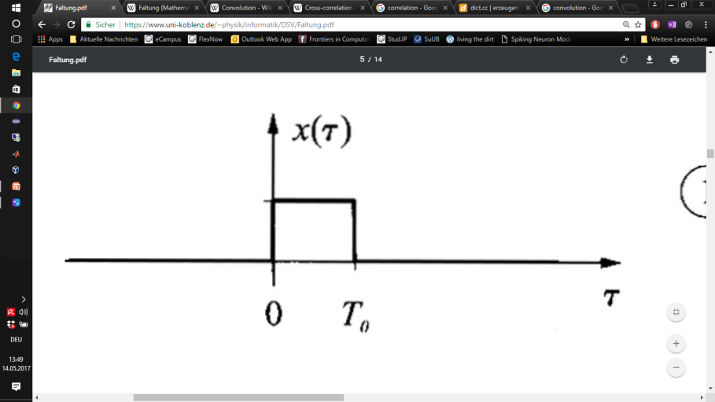
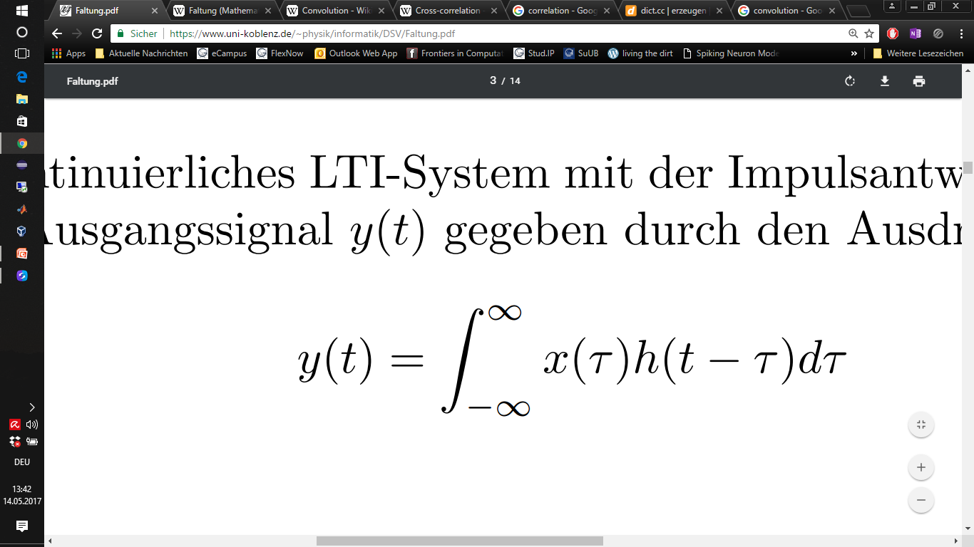
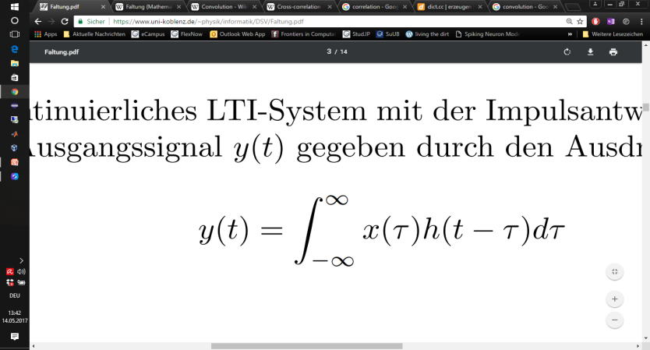
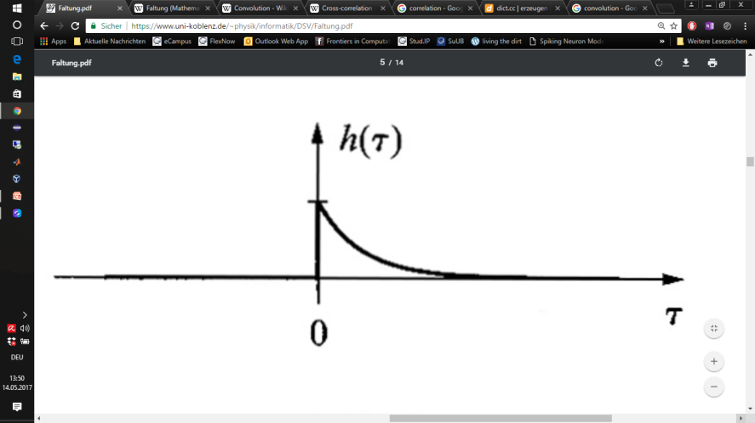
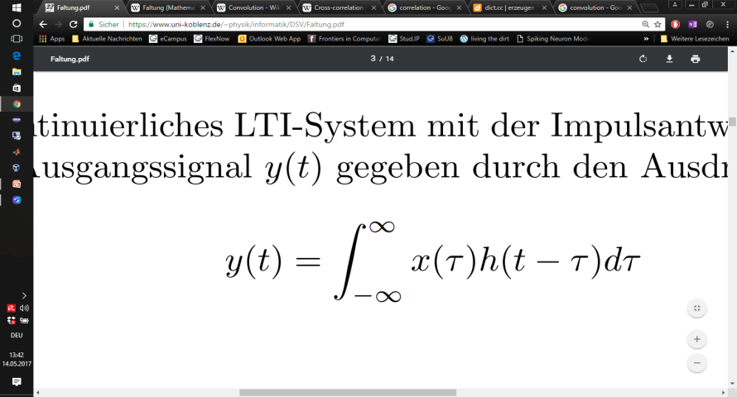
Convolution (Faltung/Folding)
x(t)
System
h(t)
y(t)
Input
Output
○
○
https://www.uni-koblenz.de/~physik/informatik/DSV/Faltung.pdf

Slide 3
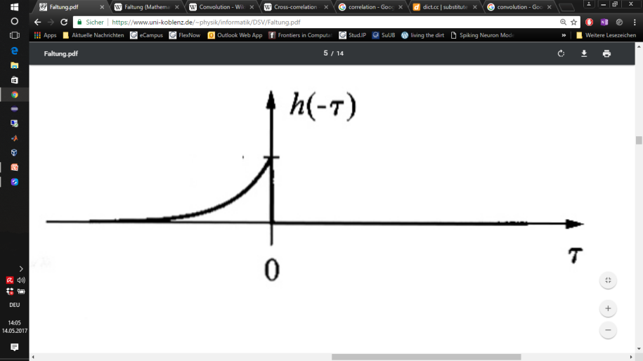
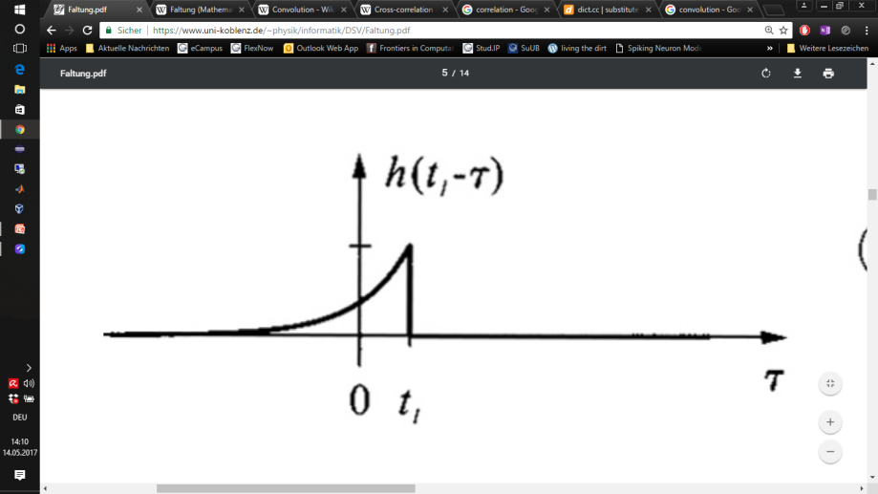
Convolution (graphical Interpretation)
x(t)
System
h(t)
y(t)
Input
Output
substitute t with τ
flip h(τ) → h(- τ)
slide h(- τ) → h(t- τ)
Integrate over d τ
https://www.uni-koblenz.de/~physik/informatik/DSV/Faltung.pdf

Slide 4

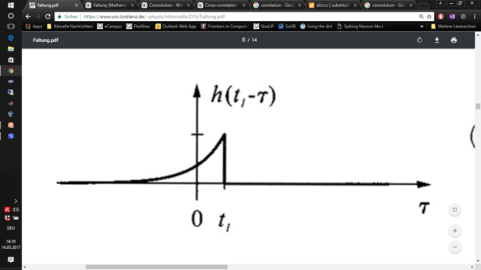
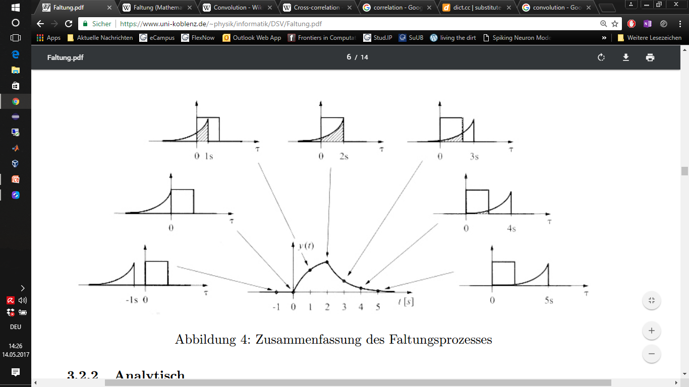
Convolution (graphical Interpretation)
4. Integrate over d τ
https://www.uni-koblenz.de/~physik/informatik/DSV/Faltung.pdf

Slide 5
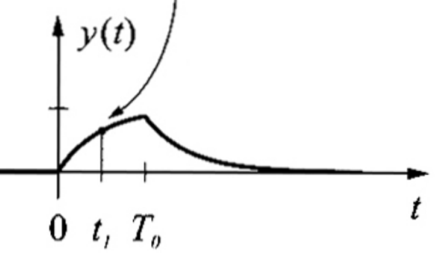
Convolution (graphical Interpretation)
x(t)
System
h(t)
y(t)
Input
Output
○
´flip and slide´
https://www.uni-koblenz.de/~physik/informatik/DSV/Faltung.pdf

Slide 6
Convolution: Properties
f ○ g = g ○ f
Commutativity
Associativity
Distributivity
Identity element: Dirac impuls
time-delayed dirac impuls → time shift in x(t)
(f ○ g) ○ h = f ○ (g ○ h)
f ○ (g + h) = (f ○ g) + (f ○ h)
x(t) ○ δ(t) = x(t)
x(t) ○ δ(t-t₀) = x(t-t₀)
https://www.uni-koblenz.de/~physik/informatik/DSV/Faltung.pdf

Slide 7
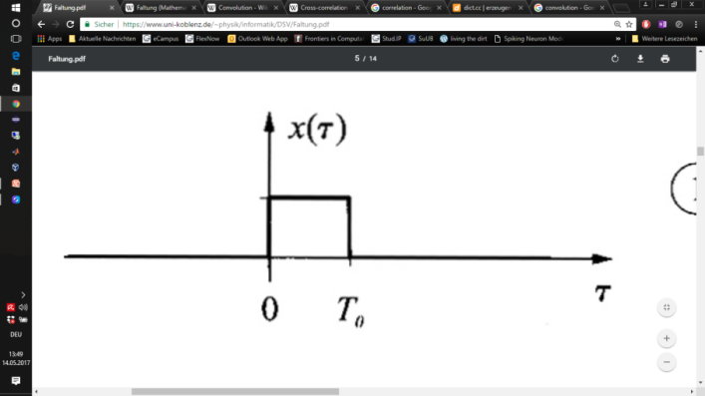

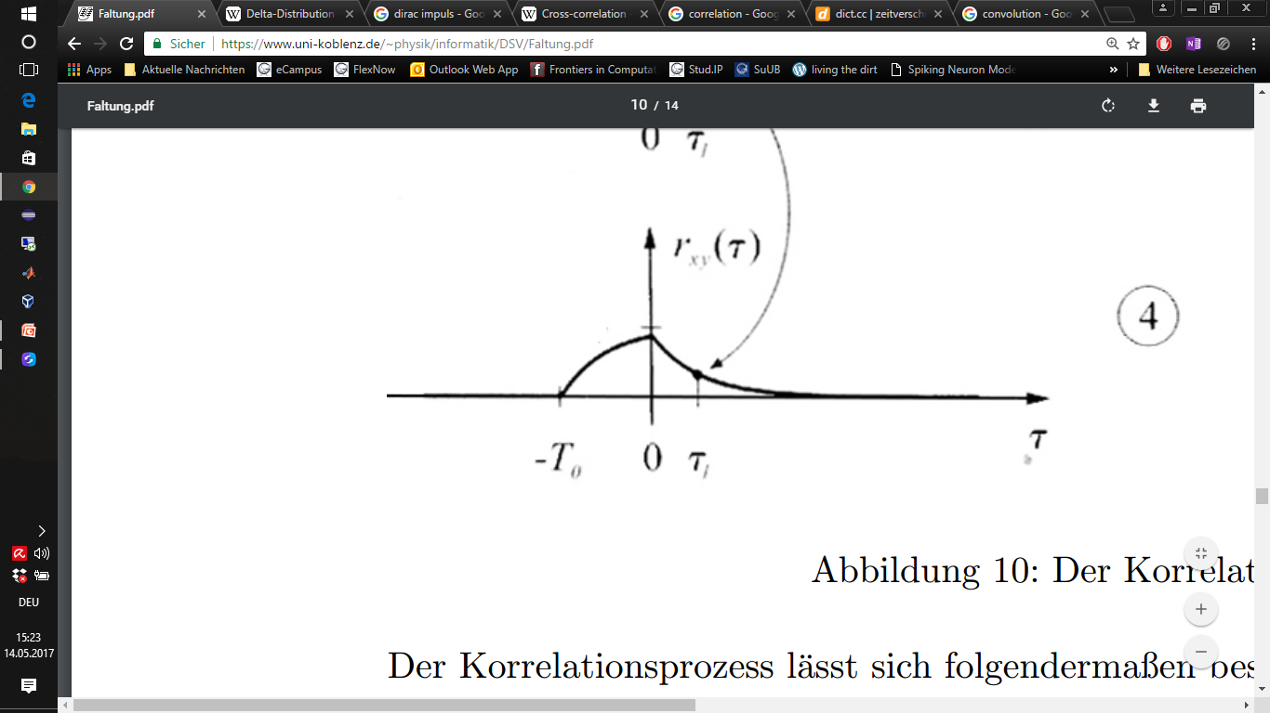
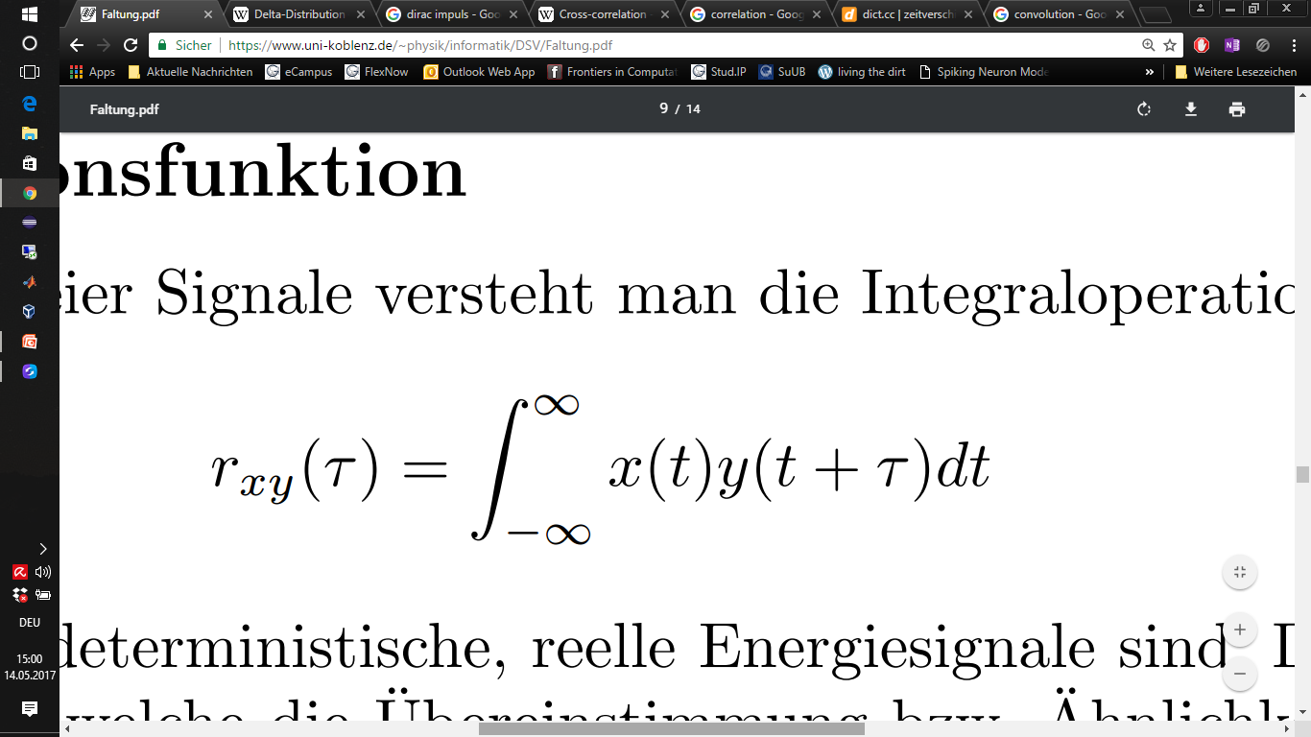
Correlation
x(t)
Input
System
y(t)
h(t)
Output
Input
*
/
*
´slide´
https://www.uni-koblenz.de/~physik/informatik/DSV/Faltung.pdf

Slide 8
Wrap up: Convolution & Correlation
Convolution
○
´flip & slide´
Correlation
´slide´
*
/
*
R.N. Bracewell, The Fourier Transform and ist Applications, McGray-Hill Publ. 1986 2nd Ed.

Slide 9
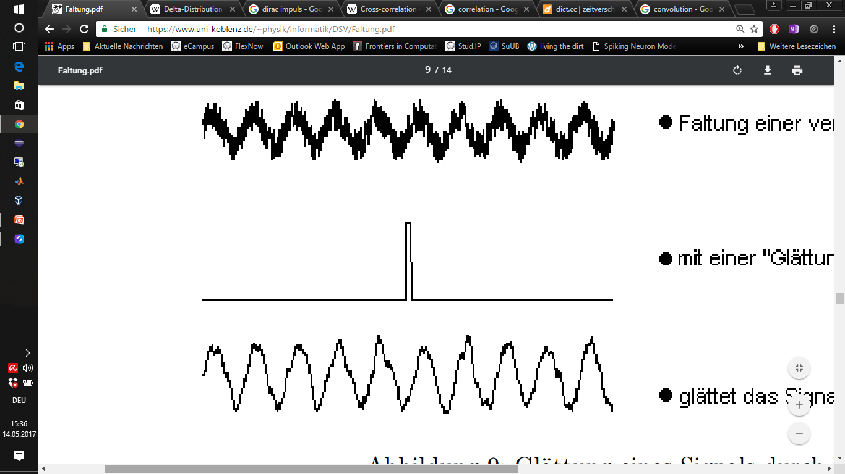
Convolution: Neurons as Filters
Neuron
Input
Output
9
https://www.uni-koblenz.de/~physik/informatik/DSV/Faltung.pdf

Slide 10
10

Slide 11
What are receptive fields within the eye?
11

Slide 12
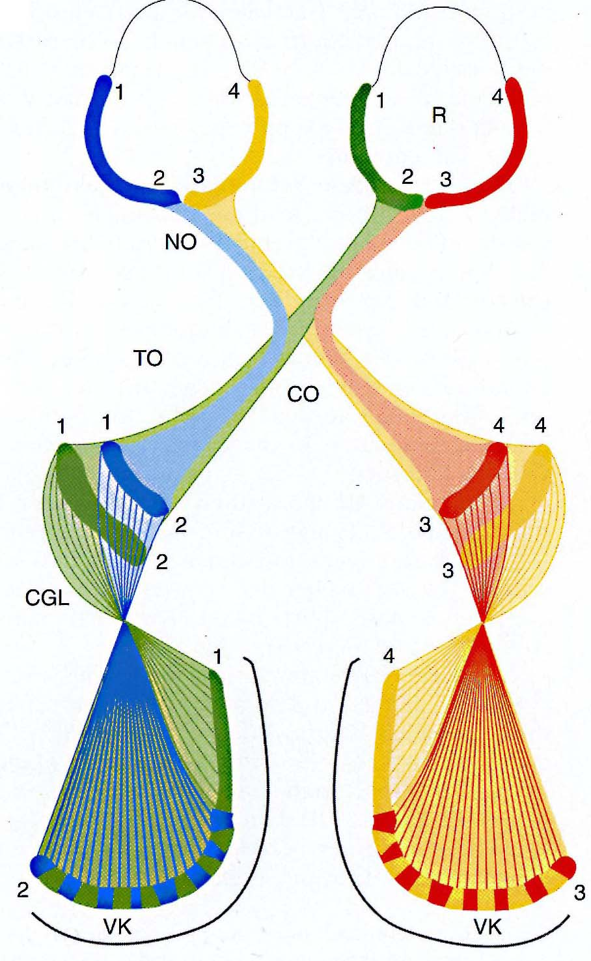
The primary visual pathway
Retina
LGN
Primary
Visual
Cortex

Slide 13
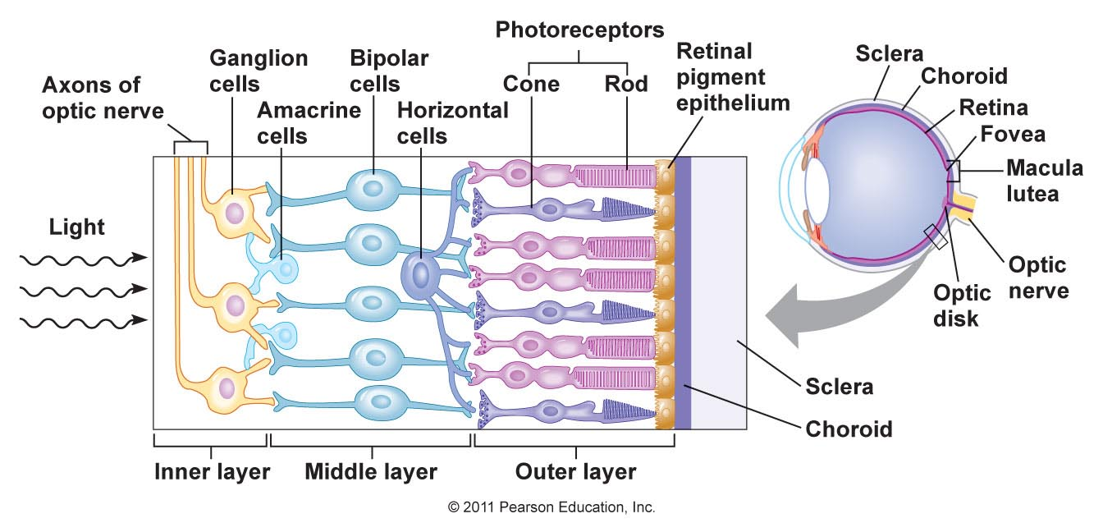
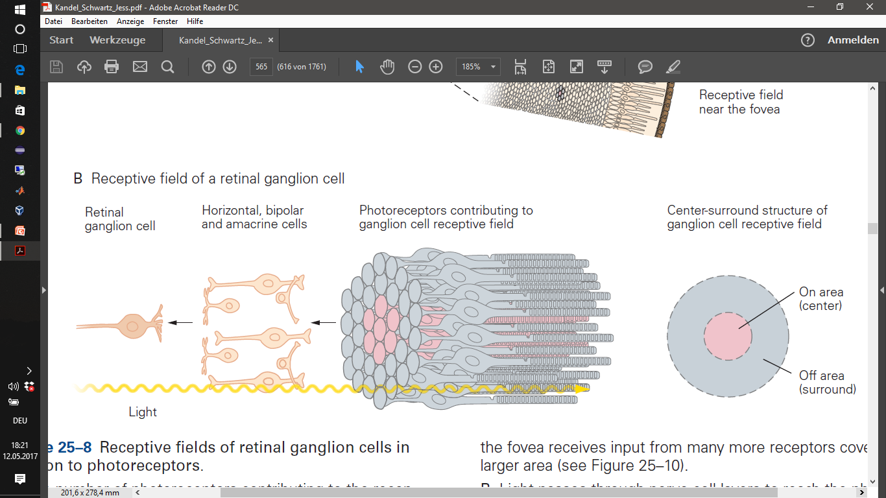
The primary visual pathway
Receptive field of a retinal ganglion cell
Center-Surround Antagonism
Kandel et al., 2000

Slide 14
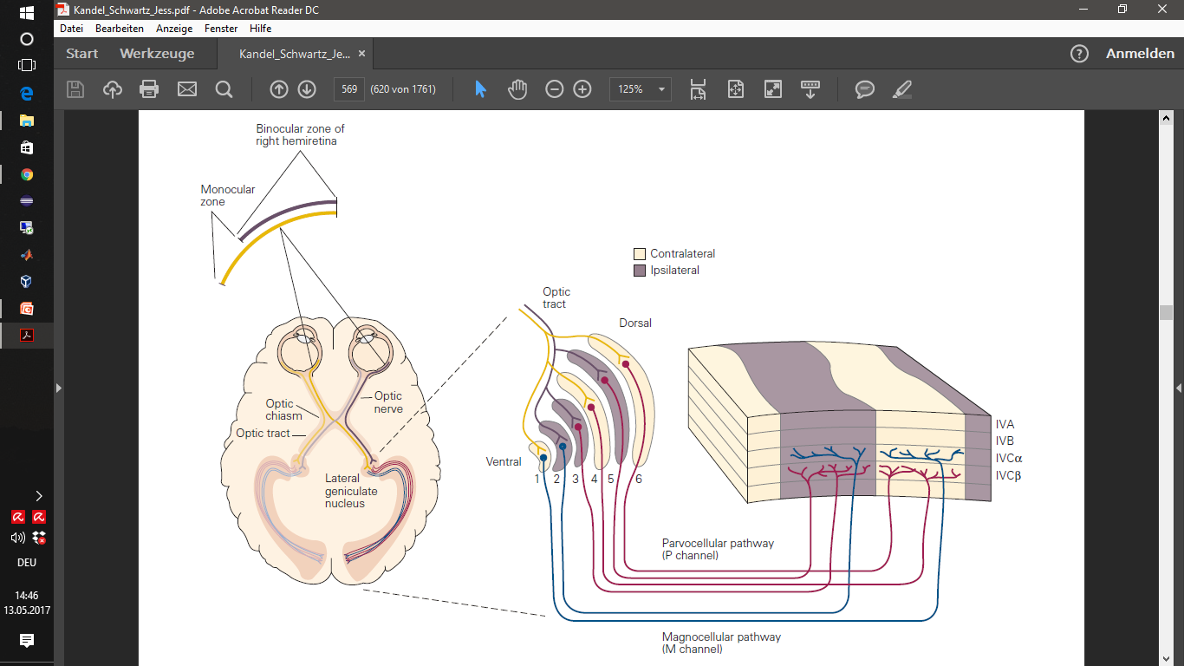
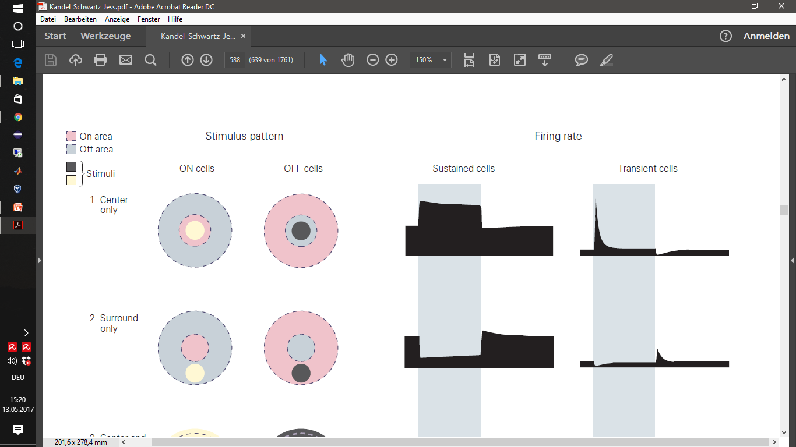
The primary visual pathway
Kandel et al., 2000
Retina
Thalamus
(LGN)
Primary Visual Cortex
elongated RFs (ON, OFF subfields) in the cortex
Cross-section through the activity profile
Center-Surround Antagonism

Slide 15
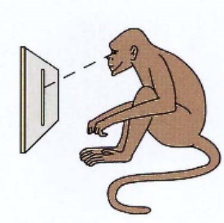
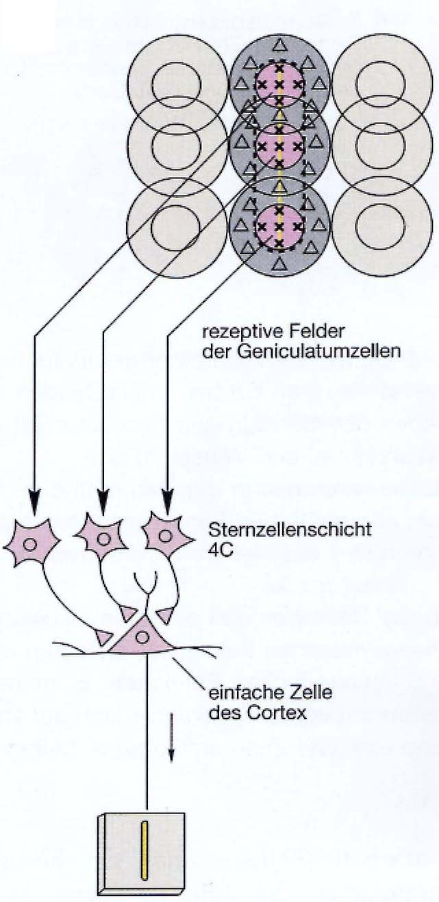
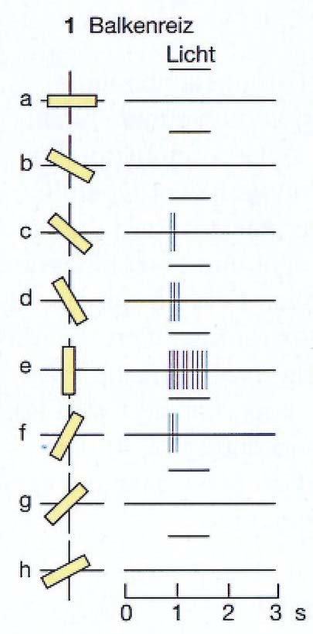
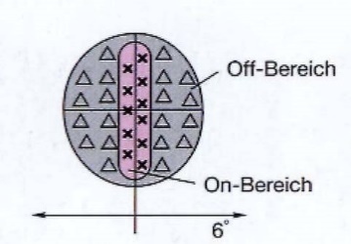
RFs explain orientation selectivity
Experimental setup
Selectivity is generated by …
Retina
Stimulation-
protocol
Response of
V1-neuron
… specific connection of
ganglion cells onto
LGN cells
LGN
… specific connection of
LGN cells onto V1 cell
V1
Remember this slide?
15
Notes:
15
A. A neuron in the primary visual cortex responds selectively to line segments that fit the orientation of its receptive field.
This selectivity is the first step in the brain’s analysis of an object’s form.
The orientation of the receptive field is thought to result from the alignment of the circular center-surround receptive fields of several presynaptic
cells in the lateral geniculate nucleus.

Slide 16
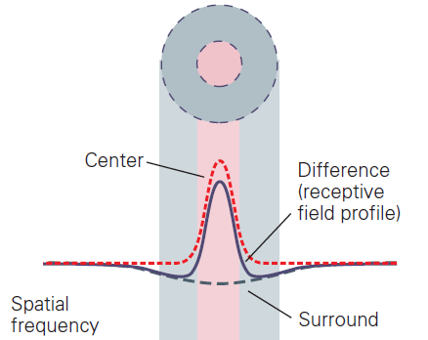
Modeling the activity profile of RFs
Famous model:
Difference of Gaussians (DoG)
Other functions with very similar shapes:
Laplacian of a 2-dimensional
Gaussian ( )
Cosine type Gabor function (1-d only)
=
Kandel et al., 2000
16
Notes:
The neuron‘s sensitivity to light at different points on the retina is modeled as a „difference-of-Gaussians“ receptive field
narrow positive gaussian for the excitatory center
broad negative Gaussian for the inhibitory surround
16

Slide 17
17

Slide 18
What does this all have to do with convolutions?

Slide 19
19

Slide 20
20

Slide 21
21

Slide 22
22

Slide 23
-
23

Slide 24
Drifting grating stimulus
24

Slide 25
25

Slide 26
The Problem of Linearity
(there are no negative cell responses)
push-pull connections
Light
No Light
Some names for it:
mutual inhibition / ON-OFF inhibition /
antagonistic inhibition

Slide 27
A Null-Response is indicative of inhibition
27
Notes:
27

Slide 28
Correlations

Slide 29
3) determine motion and sound perceptions

Slide 30
Motion is correlation in time and space:

Slide 31
Motion is correlation in time and space:

Slide 32
Motion is correlation in time and space:
This point is on at time t
This point is on at time t + τ
We see motion when two neighbouring spatial positions are stimulated with a temporal delay.
First, however, we will do
this with spikes (by hand)
before we come back to this
example !

Slide 37
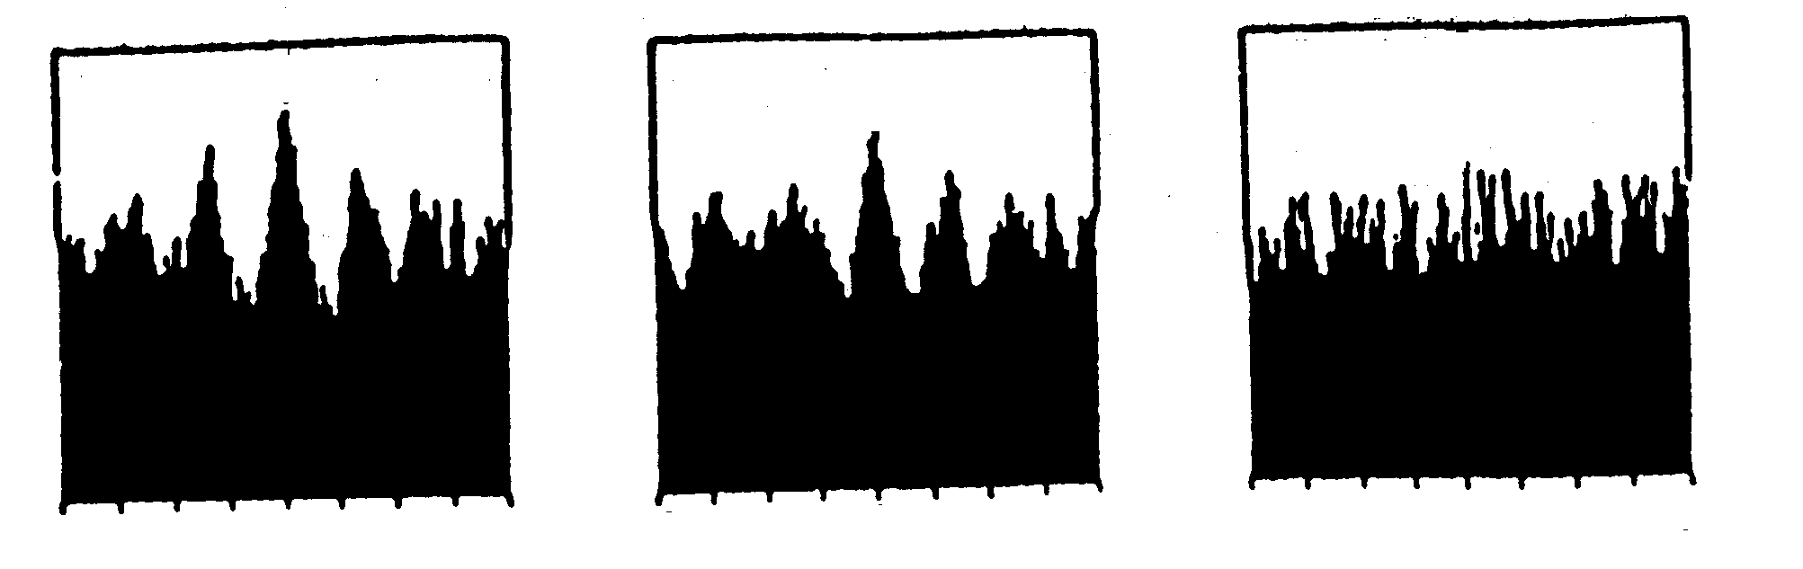

Slide 39
Motion is correlation in time and space:
This point is on at time t
This point is on at time t + τ
We see motion when two neighbouring spatial positions are stimulated with a temporal delay.

Slide 40
Motion detection by correlation:
Motion is detected by comparing the responses of two photoreceptors
The signal of the first photoreceptor is delayed by - τ
Then the comparison stage detects whether both signals arrive at the same time
Delay ( - τ )
Compare

Slide 41
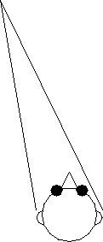
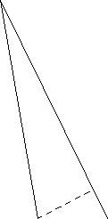
Interaural Time Difference (ITD):
Sound coming from a particular location in space reaches the two ears at different times.
From the interaural time difference the azimuth of the sound direction can be estimated.
Example:

Slide 42
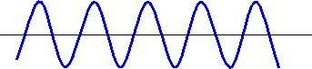
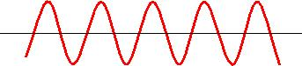
Transformation of sound to spikes:
When a sound wave of a particular frequency reaches the (left) ear, a certain set of hair cells (those that encode this frequency) become excited.
These hair cells generate spikes. These spikes always appear at the same phase of the wave.
They are „phase-locked“.
The same sound wave reaches the right ear a little later. This gives a phase shift between left and right ear. Spikes are again phase-locked to the sound wave.

Slide 43
Transformation of sound to spikes:
When a sound wave of a particular frequency reaches the (left) ear, a certain set of hair cells (those that encode this frequency) become excited.
These hair cells generate spikes. These spikes always appear at the same phase of the wave.
They are „phase-locked“.
The same sound wave reaches the right ear a little later. This gives a phase shift between left and right ear. Spikes are again phase-locked to the sound wave.
Difference in spike times ~ sound azimuth !

Slide 44
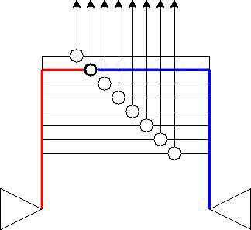
Delay line correlator:
Each neuron receives input from both ears.
Due to the lengths of the two axons, the inputs arrive at different times.
The neuron acts as a „coincidence detector“ and only fires if two spikes arrive at the same time.
=> Each neuron encodes a specific interaural time difference.

Slide 45
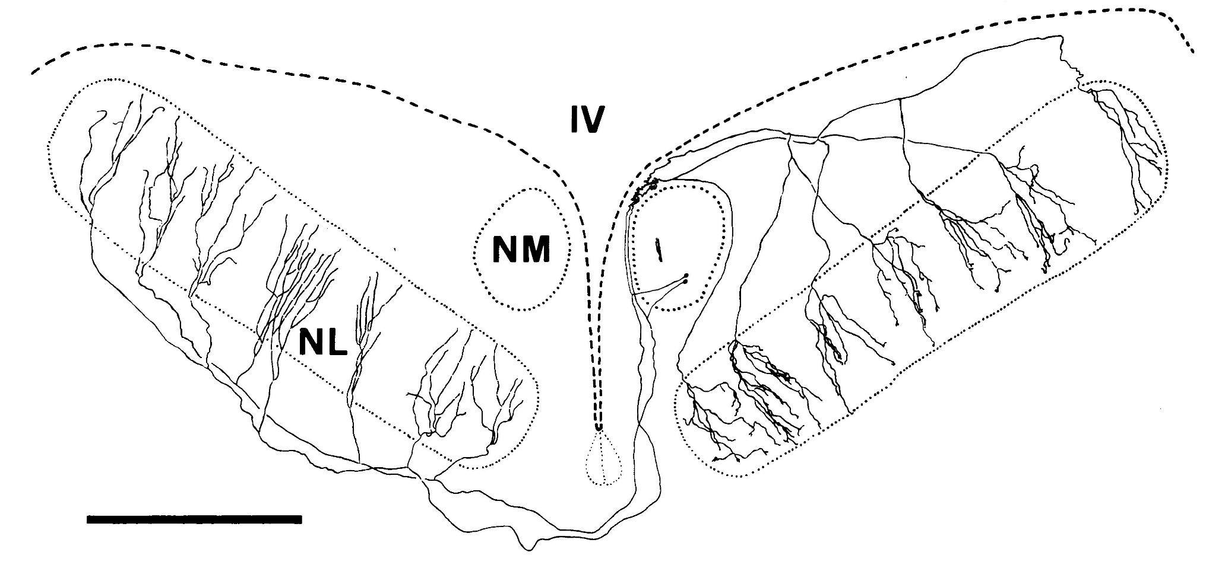
Delay lines in the owl brain:
Ear -> Auditory nerve -> NM -> NL -> LS -> ICx

Slide 46
Correlation:
Average over time
Coincidence detection
Time delay
Left spike train
Right spike train

